Slide 1
Research Project Workshop 01: Researcher Profiling
March 1, 2017
Instructor: Letisha Wyatt, PhD

Slide 2
agenda
1 Business
2 Introductions
3 GitHub introduction and set up
4 Researcher profile development
5 Get to know your data
6 Wrap up/questions
Notes:
Bit of business today

Slide 3
Git and GitHub - what are they?
“Git is a version control system for tracking changes in computer files and coordinating work on those files among multiple people.
It is primarily used for software development, but it can be used to keep track of changes in any files.”
-wikipedia
Notes:
Bit of business today

Slide 4
GitHub – why use it?
GitHub: web-based front end of Git
Repository for access control
Version control
Task management
Your sanity: document management and versioning
Free and easy sharing
Your PI/research group’s sanity: alleviate project handoff

Slide 5
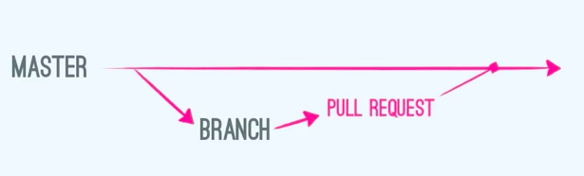
how GitHub works
http://mednoter.com/how-github-works.html
Useful terms
Fork: make a personal copy not connected to original
Branch: parallel version that you can tinker with w/o affecting the master
Commit: a change that is made with a reason provided for why (every change is recorded)
Pull: request for the Master owner to pull in changes
Issues: tasks or questions for the owner
Notes:
Glossary: https://help.github.com/articles/github-glossary/

Slide 6
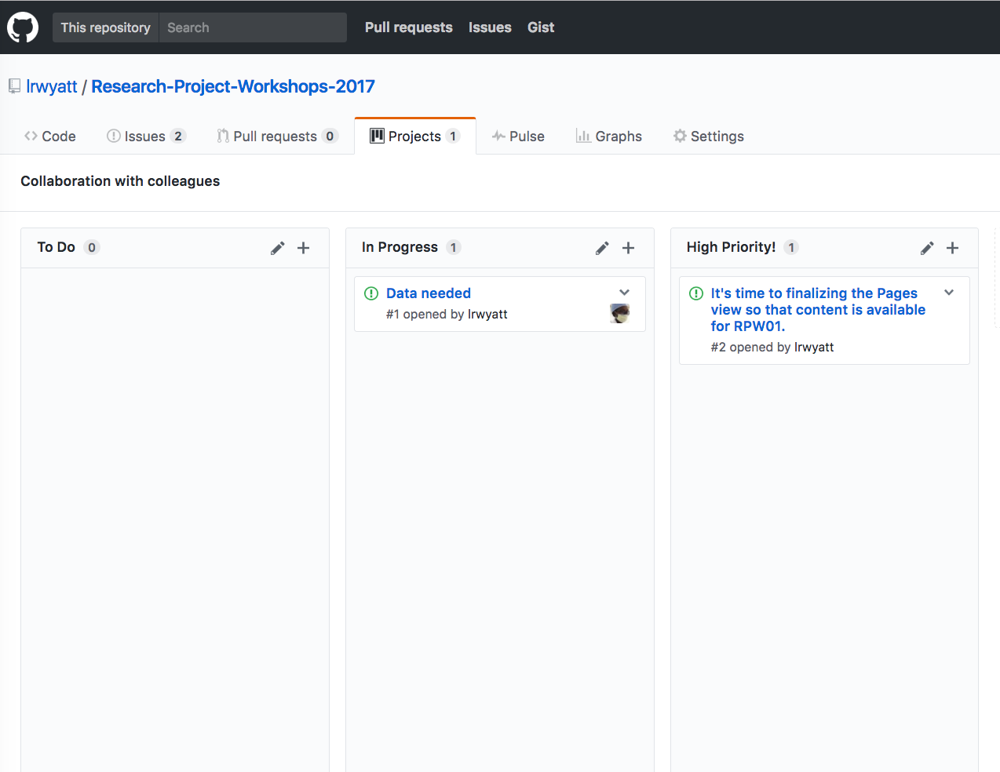
GitHub projects

Slide 7
tour…

